Slide 1


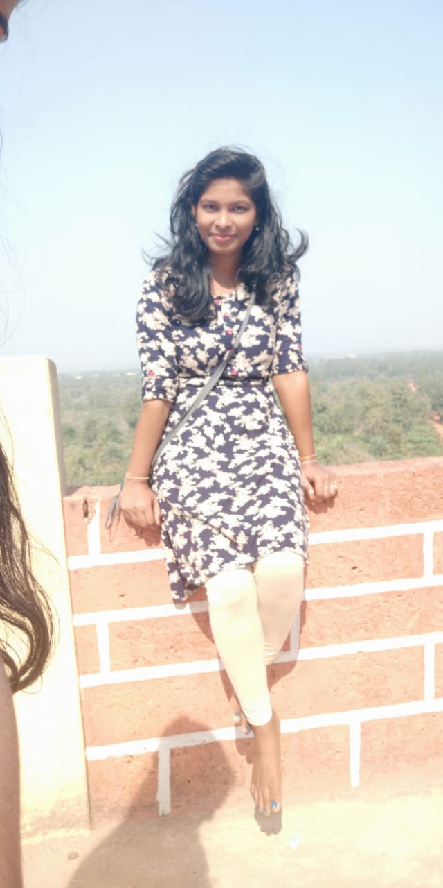
RedHat
About Me
Name: Suchitra sahoo
College: College of engineering Bhubaneswar
Github : https://github.com/sahoo97
PHOTO You Liked the Most :)

Slide 2
My learning : W1
RedHat
Achievements :
Here I am archive a lot of things in one week training experience. I am attend all the session with lot of excited and enjoyed all the session. I have geeting basic knowledge about coding and installation of centOS. I learn about SCQ and project idea.
Learnings :
Learning is the process that never end. I have learned about basic of linux command, concept and all over fundamental function.
I also learned python programming , that is easy to understand and progress.

Slide 3
RedHat
<Project Title>
SCQ:
Situation: Rented Housing management
There are many people want to a good home for rent. Many people leave their homes and stay outside because they have a different working place . They also have to waste their time and did not get a good house.
Challenge: we will collect data about houses, who want to rent their house.
Question: How to search that houses?
How will develop an app. which will be simple that problem?
User stories:
As< devloper> I want to develop an app so that all are getting and communicate more efficiently
Ex: e-houesing society

